Slide 1
Chapter 3
USE CASE DIAGRAM ( UCD )
Notes:
Session: Ghi số thứ tự session trong môn học
Session Name: ghi tên của session sẽ dạy

Slide 2
Session Objectives
When you’ve finished this session, you should be able to:
Understand about UCD
Understand how to develop and UCD
How to use an UCD

Slide 3
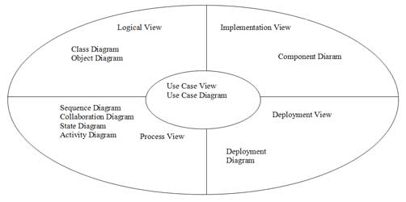
UML Diagram & View

Slide 4
Use Case introduction
Use cases are a technique for capturing the functional requirements of a system.
Use cases work by describing the typical interactions between the users of a system and the system itself, providing a narrative of how a system is used.

Slide 5
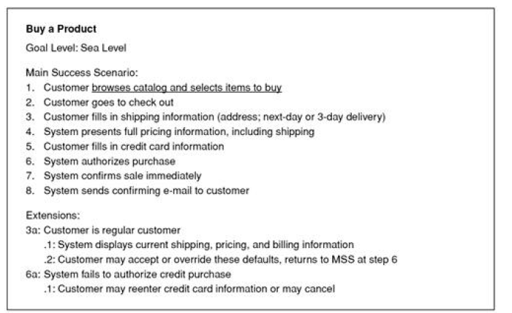
Example of Use Case

Slide 6
Components of Use Case Diagram
Any system that has to be implemented will have has several users. Each user may use the system for different purpose.
Actor: User or Another system that interacts with the system.
Use Case: describes a number of external actors and their connections to system functions that the system provides.

Slide 7
Elements of UCD
System Boundary
A rectangular box depicts the boundaries of the system. It is describe a system or subsystem.
System Name

Slide 8
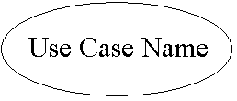
Elements of UCD [Cont…]
Use Case
A solid ellipse depicts a Use Case. The Name of the Use Case id written within the ellipse.

Slide 9
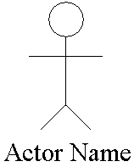
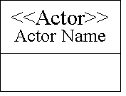
Elements of UCD [Cont…]
Actor

Slide 10
Elements of UCD [Cont…]
Connector
Association
Directed Association
Dependencies
I
Include
E
Extend
Generalization

Slide 11
Putting UCD symbols together
Submission of Withdrawal slip
Password verification
Customer
Update balances
Teller
Savings Account

Slide 12
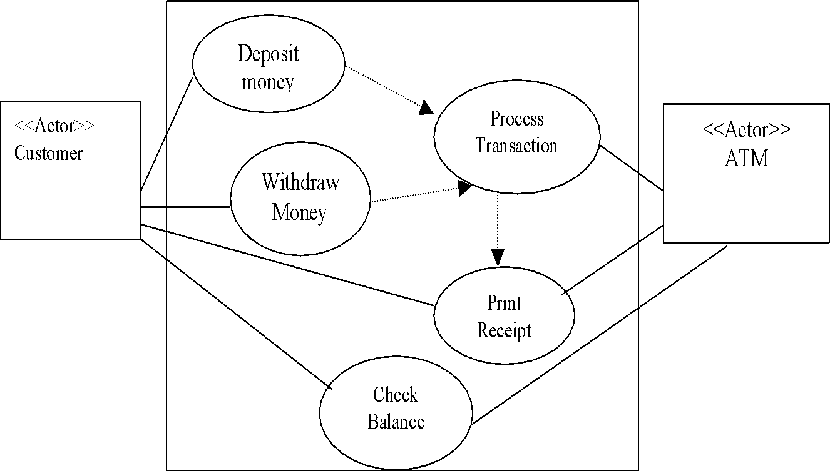
Other UCD Example [Cont.]
ATM Systems example

Slide 13
Use Case Relationship
There are two types of relationship:
Include
Extend

Slide 14
Include Relationship
An include relationship defines that a use case contains the behavior defined in another use case.
ATM Password
< Include Use Case
Verification
I
Login
< Base Use Case
Use Case ATM Password verification as an include use case signature verification

Slide 15
Extend Relationship
When a number of use cases have a common behaviour which can be modeled in a single use case and that can be used by other use cases, such a relationship is called Extend relationship.

Slide 16
Extend Relationship [Cont.]
“Deposit Money” use case uses “Password Verification” and “Print Receipt”
Deposit Money
E
E
Password Verification
Print Receipt

Slide 17
Summary Use Case Relationships
ATM System for Bank
Deposit
I
Stuck deposit
Money
Envelope
<<Actor>>
<<Actor>>
Customer
Withdraw
Verify
ATM
Money
Password
I
Show
Overdrawn
Balance
Pint Receipt

Slide 18
Writing a Use Case
To describe details of a use case we need to write to describe Use Case.

Slide 19
Writing a Use Case
Use Case Specification
Account Details // Use Case name
Use Case number UCSEC35
Brief Description// Brief description of a use case
Flow of Events // Verbose on logical flow
Basic Flow // Detailed logical flow

Slide 20
Writing a Use Case [Cont.]
Alternative Flows // Alternate Logical paths
Exit Options // How does use case exits?
Special Requirements // Mention special requirements
Pre Requirements // What happens before the use case is executed?
Post Conditions // What happens after the use case is executed?

Slide 21
When to use Use Case Diagram
Use cases are a valuable tool to help understand the functional requirements of a system.
It is important to remember that use cases represent an external view of the system. As such, don't expect any correlations between use cases and the classes inside the system.
Keep it simple to easy understand. We can using activity to detail describe use case

Slide 22
Practice to build a UCD
Find the Actor
Who or System use this system?
Find Use Case
What the Actor use system?
Analysis Extend and Include Use Case
Draw a Use Case Diagram
Write Use Case to understand the system

Slide 23
Q&A?

